Slide 1
2020 WIC Vendor Training
Presented By:
Kirsten Hevener- Nevada WIC
Gina Gimenez- Nevada WIC
Tina Moreno- ITCN WIC

Slide 2
Course outline
What is WIC and why is WIC Important?
WIC Approved Foods and Food Packages
WIC Shopping, Transactions, UPC Submissions and the Claims Procedure
Vendor Rights and Responsibilities
Complaints
Vendor Tools and References

Slide 3
What is WIC and why is WIC Important?

Slide 4
What is WIC?
WIC is a federally funded Supplemental Nutrition Program for income eligible pregnant, postpartum and breastfeeding women, infants and children up to age 5 who are at nutritional risk

Slide 5
Why is WIC Important?
The WIC Program aims to help safeguard the health of low-income women, infants and children up to age 5 who are at nutrition risk by providing the following:
Nutrition education that provides information on healthy eating
Promoting and supporting breastfeeding as an important part of the nutrition benefits WIC Participants receive
Health and social services referrals
Nutritious foods to help supplement diets

Slide 6
Why are WIC Vendors Important?
WIC Vendors are a VITAL part of the Nevada WIC Program:
Vendors supply the nutritious foods needed to build healthy families
All Vendor Staff are important in making the shopping experience work for WIC Participants
Without Vendor partners, The Nevada WIC Program could not reach our goals helping families eat healthier foods
This Photo by Unknown Author is licensed under CC BY-SA
This Photo by Unknown Author is licensed under CC BY

Slide 7
Public Charge Rule. What is it?
Public charge allows federal authorities to deny legal status to individuals who are determined to rely on government assistance. Individuals determined to be a public charge could be denied a visa or green card.
Certain federal programs limit eligibility for non-citizens. Many immigrants must wait at least five years before obtaining eligibility for SNAP benefits, commonly known as food stamps.
Help Stop the spread of misinformation
WIC is one of the few programs that Congress elected NOT to limit eligibility based on citizenship or immigration status.

Slide 8
WIC Approved Foods and Food Packages

Slide 9
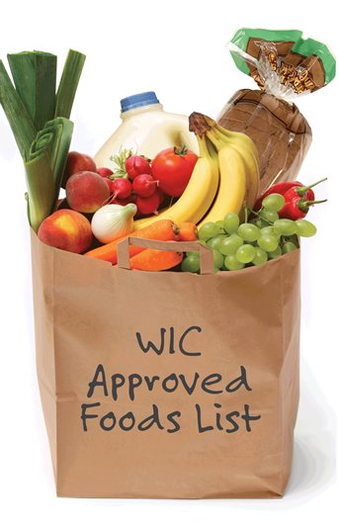
Authorized WIC foods
Milk
Yogurt (whole milk, low-fat and non-fat)
Eggs
Cheese
Dry Beans, Peas and Lentils
Canned Beans
Peanut Butter
Iron-Fortified Cereal
100% Fruit and Vegetable Juices
Fresh, Frozen and Canned Fruits and Vegetables
Varieties of Canned Fish
Whole Grains choices including 100% whole-grain and whole wheat bread, brown rice, soft corn and whole wheat tortillas and whole wheat pasta
Tofu
Soy Beverages
Iron-Fortified Infant Formula
Infant Cereal
Jarred Baby Food Meats, Fruits and Vegetables

Slide 10
Unauthorized Foods
NOT ALLOWED:
Herbs: i.e. basil, cilantro, dill, sage, rosemary, etc.
Individually wrapped cheese slices
Nut butters or spreads
Food with high sugar content
Nut or rice milk
Foods not appearing on a Participant’s shopping list or balance inquiry

Slide 11
Least Expensive Brand Requirement
WAIVED DURING COVID
The Least Expensive Brand (LEB) Requirement means that WIC Participants can only purchase the least expensive brand available at the store for the following items:
Eggs
Milk
Orange Juice
Pineapple Juice

Slide 12
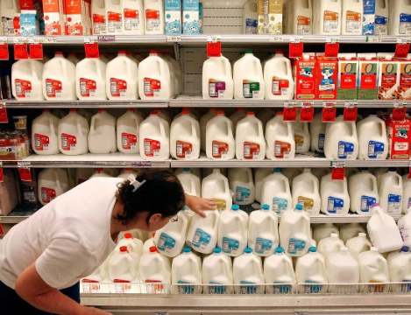
Milk
Types of milk issued are dependent on the age of the Participant
Children 1-2 years of age are issued whole milk
Children 2 years of age and over, pregnant, postpartum and breastfeeding women are issued 1%, skim or fat free milk
Milk is issued to Participants in quarts or .25 gallons
Example: a Participant is issued 3.25 gallons and may redeem the milk in any size -
Gallons (1.0 gallon), half gallons (.5 gallon) or quart (.25 gallon)
Remember: Milk is a Least Expensive Brand (LEB) Requirement for whole, 1%, skim and fat free LEB is waived during COVID

Slide 13
Milk Options
Goats Milk
Powdered Milk
Soy Milk (refrigerated and shelf stable)
Evaporated Milk
UHT Milk
Lactose Free/Reduced Milk (whole and low fat)
Acidophilus (1% and 2%)
Nut and rice milks are not allowed

Slide 14
New Foods in 2020
Varieties of Yogurt
Sizes and Types of Cheese
Cereal Brands
Juice Brands
Canned Fish Types
Organic Infant Cereal
Organic Baby Fruits and Vegetables

Slide 15
Yogurt
Types of yogurt issued are dependent on the age of the Participant
Children 1-2 years of age are issued whole milk yogurt
Children 2 years of age and over, pregnant, postpartum and breastfeeding women are issued low fat or nonfat yogurt.
Yogurts not allowed include:
Drinkable
“Light”

Slide 16
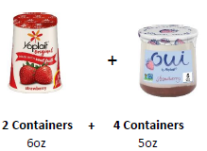
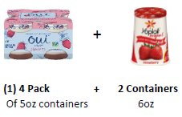
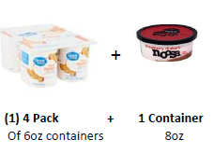
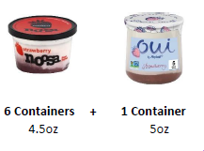
New Yogurt Options
New sizes include:
3.5 oz
4.5 oz
5 oz
5.3 oz
6 oz
8 oz
21.2 oz
24 oz
New Flavors include desserts such as key lime pie

Slide 17
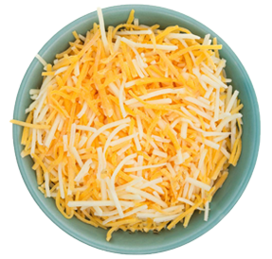
New Cheese Options
8 oz sizes
Shredded
Cubed
Swiss
Muenster

Slide 18
New Cereal Options
House brand cereals
Great Value
Kroger
Raley’s
Signature Select
Winco

Slide 19
New Juice Options
New brands include:
Ocean Spray
Great Value
Raley’s Grapefruit Juice
Kroger Grapefruit Juice
Signature Select
Winco

Slide 20
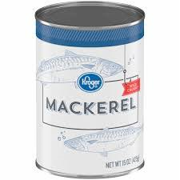
New Canned Fish Options
Mackerel
5 oz
6 oz
15 oz
Salmon
5 oz
6 oz
14.75 oz
15 oz

Slide 21
The Legume Benefit. What Does it Mean? Dry Beans, Peas, Lentils, Canned Beans and Peanut Butter
Participants have the following options to redeem their Legume benefit:
Peanut Butter 16-18 oz jar (1)
Dry Beans, Peas, and lentils 16 oz bag (1)
4 Cans of Beans 14-16 oz size
Once one can of beans has been purchased the remaining increments must be redeemed with only canned beans

Slide 22
WIC Tailors Food Packages to Participants
Infant food packages:
0-6 months
Infant formula as listed on the participants benefit list
6-11 months
Infant Formula
Infant Cereal
Infant Fruits and Vegetables
Infant Meats (for exclusively breastfed infants only)

Slide 23
WIC Tailors Food Packages to Participants
Toddler food package: 12-24 months
Cheese
Yogurt (whole milk)
Whole Milk
Eggs
Cereal
Legumes
Whole Grains
Fruits and Vegetables $8 cash value benefit (CVB)
Single Strength Juice

Slide 24
WIC Tailors Food Packages to Participants
Child food package: 2-5 years
Cheese
Yogurt (low fat)
Milk – 1%, skim or fat free
Eggs
Cereal
Legumes
Whole Grains
Fruits and Vegetables $8 cash value benefit (CVB)
Single Strength Juice

Slide 25
WIC Tailors Food Packages to Participants
Pregnant and Post-Partum Women’s food package:
Cheese
Yogurt (low fat)
Milk – 1%, skim or fat free
Eggs
Cereal
Legumes
Whole Grains (pregnant women only)
Fruits and Vegetables $11 cash value benefit (CVB)
Frozen juice concentrate

Slide 26
WIC Tailors Food Packages to Participants
Breastfeeding Food Package:
Cheese
Yogurt (low fat)
Milk 1%, skim or fat free
Eggs
Cereal
Legumes
Canned Fish
Whole Grains
Fruits and Vegetables $11 cash value benefit (CVB)
Juice Concentrate

Slide 27
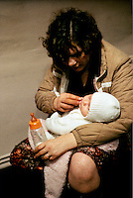
WIC Tailors Food Packages to Participants
Homeless Food Package
Convenience Pack Juice
UHT Milk
Additional quantity of Canned Beans or Peanut Butter in lieu of Eggs
Cereal
Whole Grains
Fruits and Vegetables $11 cash value benefit (CVB)
Ready to Feed Infant Formula

Slide 28
WIC Shopping, Transactions, UPC Submissions and the Claims Procedure

Slide 29
WIC Shopping
WIC food benefits are issued to Participants on an Electronic Benefit Transfer (EBT) Card
WIC Participants must set a PIN on the EBT card prior to shopping
In the clinic Participants are given their shopping list and provided information on WIC foods
Shopping for WIC foods can be difficult at times and sometimes Participants need a bit of assistance while in the store

Slide 30
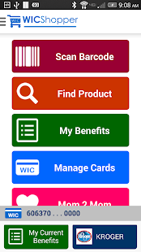
WICShopper App
The WICShopper app helps Participants shop by making it easier to identify WIC Approved foods which simplifies the WIC Shopping experience
Participant’s can view their available balance, get recipes and more
The app allows Participants to scan UPC’s while shopping letting them know if the item is WIC Approved and the quantity, they have available
The WICShopper app is also a tool Vendors can use to assist in applying shelf labels to the correct WIC approved foods

Slide 31
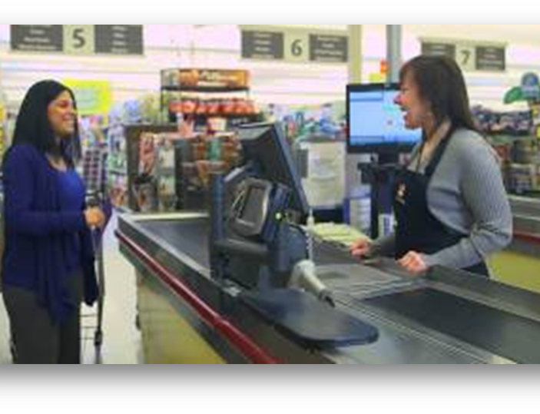
Transaction Procedure for Processing eWIC
All store Point-of-Sale systems work different. To lessen the chance of possible issues at the cash register it is best to:
Scan ALL items individually
If an item does not scan as WIC eligible, the Participant must be given the option to pay or remove the item prior to the finalization of the transaction
Cash Value Benefit (CVB) – if a purchase goes over the dollar amount available, the Participant has the option to pay the difference or not purchase the items

Slide 32
Transaction Procedure (continued)
Remember Cashiers must scan every item a Participant brings to the register
If a scanned WIC food does not go through, tell the Participant the error message
If possible, offer the Participant the option to take a picture of the error message
Ensure each item is scanned individually
The only instance where a Cashier can make a WIC food eligibility determination is for LEB items (milk, eggs, pineapple and orange juice Remember LEB is waived at this time.

Slide 33
Scanning Issues
If a known WIC approved food is suddenly not scanning. Here are the troubleshooting steps Vendors need to take:
STORE STAFF need to contact the Store’s IT Department and report the error
Verify the APL file downloaded correctly
If your store has a stand beside device to process WIC transactions, Staff must contact the FIS Helpdesk for assistance at 877-291-0433. *Location ID is listed on the terminal. Remember to download the APL file nightly on stand beside devices

Slide 34
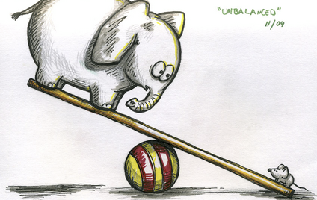
Balancing
Each business day, Vendors must balance or reconcile their transaction receipts. If Vendors discover that the net values or amounts of these items do not match, there may be an out-of-balance situation
If an out of balance situation is discovered a claim/adjustment request must filed

Slide 35
Claim Adjustment-Integrated Stores
How do I file a claim/adjustment request?
Stores with an integrated Point-of-Sale system need to contact their Third Party Processor for assistance
The error must be reported within four (4) calendar days of the transaction date to file an adjustment request
If the error is not reported within four (4) calendar days of the transaction, the request may be denied

Slide 36
Claim Adjustment-Stand Beside Terminals
How do I file a claim / adjustment request?
Call the FIS Help desk at 1-877-291-0433 within four (4) calendar days of the transaction date to file an adjustment request
If the error is not reported within four (4) calendar days of the transaction, the request may be denied
The FIS Help Desk will collect the necessary information regarding the transaction, including a copy of the receipt and will submit an adjustment request on the Vendor’s behalf

Slide 37
Vendor Rights and Responsibilities

Slide 38
Vendor Rights and Responsibilities
Courtesy
Complaints
Vendor Incentive items
Sanctions
Minimum Stocking Requirements
Infant Formula Suppliers
Routine Monitor Overview
Vendor Tools and References

Slide 39
Courtesy
Treat WIC Participants with the same courtesy and respect given to any other customer
Participants may not be discriminated against because they are on WIC
WIC Participants must be able to shop at your store during the store’s regular business hours
WIC Participants must treat Vendors with courtesy

Slide 40
Restrictions on Vendor Incentive Items
Incentive items offered to all shoppers/customers are allowed and should be provided to all WIC Participants
The following incentives are allowed and will not be considered soliciting WIC Participants if offered to all shoppers:
The use of coupons
Buy one/get one free
Store memberships/discounts
Store club cards
Employee discount cards for store employees who are WIC Participants
Incentives aimed at WIC Participants only are NOT allowed.
Use of WIC Logo in advertisement is strictly prohibited

Slide 41
Minimum Stocking Requirement (MSR)
Minimum Stocking Requirements have recently been modified and simplified
More accommodating to Vendors, while still allowing adequate access to WIC foods for Participants
Concentrate versions of formula are no longer a minimum stock requirement
Vendors are required to meet minimum stocking requirements at all times
FLEXIBILITY FOR MINIMUM STOCK DURING COVID

Slide 42
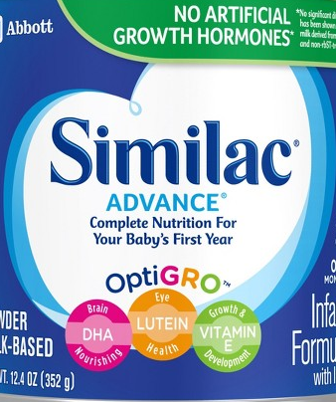
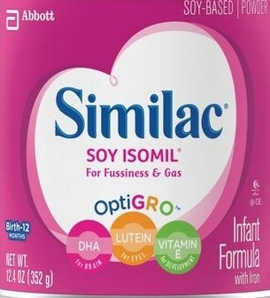
Infant Formula
All Vendors MUST carry the required contract Infant Formulas:
Milk Based: Similac Advance
UPC: 070074559582
Soy Based: Similac Soy Isomil
UPC: 070074559643

Slide 43
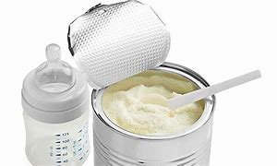
Infant Formula Suppliers
Vendors MUST purchase Infant Formula from a provider listed on the Authorized Infant Formula Supplier List
Ensures an authentic product is being sold to WIC Participants
Helps prevent counterfeit formula sales
This requirement is in place to protect both the Participant and the Vendor

Slide 44
Sanctions
Sanctions can be imposed for a number of violations:
Failure to maintain minimum stocking requirements
Selling unauthorized foods
Returning WIC purchases for cash or exchanging for different items
Overcharging for WIC items
Failure to keep at least one WIC lane open at all times
Failure to maintain or provide purchase records for infant formula
Other areas as outlined in the Vendor Sanction Schedule

Slide 45
Routine Monitor Overview
Routine monitors are performed for both randomly chosen and high-risk stores
WIC Staff conducting the routine monitor will walk the store, some of the items they will be looking for include:
Stocking levels
Shelf Prices
Correct placement of WIC Approved Shelf Tags
Vendors are required to provide a copy of Infant Formula Invoices
Indicate where the Health Permit is posted

Slide 46
Complaints

Slide 47
Complaints
If necessary, complaint forms are available to both Participants and Vendors
Complaints may include, but are not limited to:
Participants trying to return food purchased with WIC benefits for a cash refund
Participants who are verbally or physically abusive
Vendors not meeting minimum stock requirements
Vendors denying Participants WIC approved food items
Vendors treating WIC Participants with lack of courtesy or violating Participants confidentiality

Slide 48
Filing complaints
To file a complaint, please complete the complaint form via the Nevada WIC website https://nevadawic.org/contact/. This form can be found under the Contact tab. Please list as much information as possible.
You may also call the Nevada State WIC office at 775-684-5942 to file a complaint.
To file a complaint with ITCN WIC please complete the complaint form via the ITCN WIC website https://itcnwic.org.

Slide 49
Vendor Tools and References

Slide 50
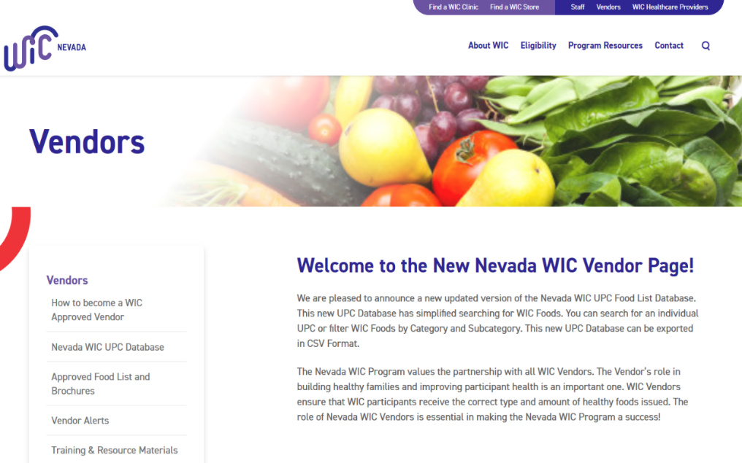
New Website is Live!
Changes include:
The new WIC UPC Database with simplified search capabilities.
You can narrow foods down by categories, subcategories, item description or UPC
Vendor Alerts with current information on the Nevada WIC Program
Ordering Form
Door Signs
Lane Markers
Shelf Tags

Slide 51
UPC’s and Vendors
Manufacturers often change packaging including the UPC. Nevada WIC staff work diligently to keep the APL file and website current
Submit new UPC’s to the State WIC Office. If Nevada WIC does not have the new UPC/PLU, it cannot be added to the APL file
Your assistance is key in keeping the APL file updated with new WIC eligible items

Slide 52
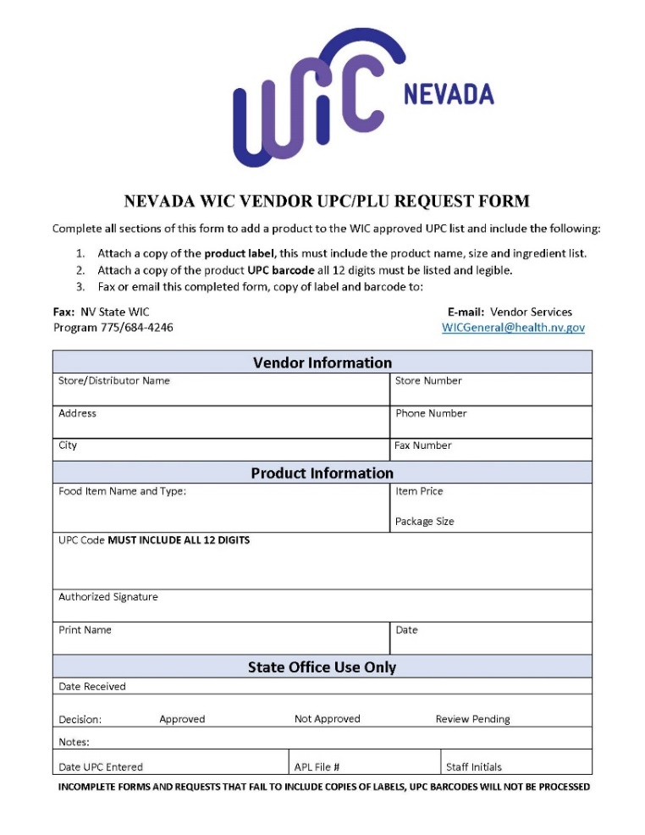
Submitting a UPC Request
Steps to take when submitting a UPC request to the State WIC Office:
Complete the UPC Request form
Include a clear image of the product label that shows the name, ingredient list and size
A picture of the UPC barcode
Ensure all 12 digits of the UPC are included
Send the submission via fax to: 775-684-4246
Or send an email to the State WIC Office: wicgeneral@health.nv.gov

Slide 53
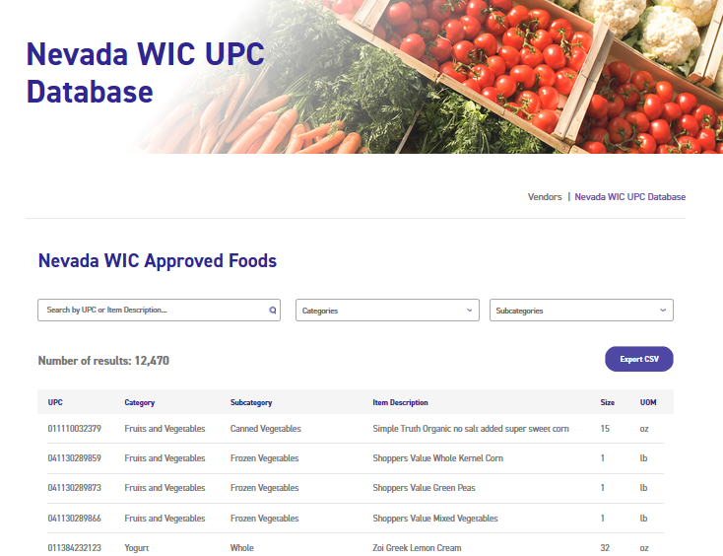
UPC Reminders
Nevada WIC adds new items and updates the Nevada WIC UPC Database on a monthly basis.
Nevada WIC UPC Database can be accessed at:
http://nevadawic.org/vendors

Slide 54
WIC Approved Shelf Tags
The use of yellow WIC approved shelf tags is strongly encouraged. They are an excellent tool for both Vendors and Participants
Shelf tags help WIC Participants identify WIC Approved items at your store lessening confusion at the register
To order shelf tags contact the Nevada State WIC Office or order online at http://nevadawic.org/vendor/Training & Resource Materials
The WICShopper App can be used to help determine if an item is WIC Approved ensuring correct shelf tag placement

Slide 55
Important Reminders
ALL WIC SALES ARE FINAL
All WIC purchases are tax exempt
WIC foods may not be returned for cash
Scan every item individually and let the system decide if it is WIC approved
It is the responsibility of the Store’s Staff to contact their IT Department if a WIC Food does not scan
Participants are allowed to pay the difference for fruit and vegetable purchases exceeding their cash value benefit (CVB)
LEB categories are milk, eggs, orange and pineapple juice
Coupons MUST be accepted if presented
WIC foods may ONLY be exchanged for the exact same foods and ONLY if the can/container is damaged or expired
WIC is one of the few programs that Congress elected NOT to limit eligibility based on citizenship or immigration status.

Slide 56
Exciting Updates for 2021
New Food Brochures
Updated Cashier Cards
Updated Vendor Manual

Slide 57
Questions?

Slide 58
THANK YOU!
The Nevada WIC Programs value the partnership we have with all our Vendors
Without strong Vendor partnerships WIC cannot serve families in Nevada
The WIC Programs want to strengthen the partnerships with all WIC Vendors. Vendor partners will soon begin to receive newsletters and emails regarding new efforts to make the WIC shopping experience easier for both Store Staff and Participants. Nevada WIC Program Staff welcome your ideas, input and partnership on streamlining and enhancing the WIC shopping experience!

Slide 59
Questions? Comments? We’d love to hear from you!
State of Nevada WIC Program Office: 775-684-5942
http://nevadawic.org
Inter-tribal Council of Nevada: 775-355-0600
http://itcnwic.org
This publication was produced by the WIC program of the Nevada State Division of Public and Behavioral Health with funding through grant number 7NV700NV7 from United States Department of Agriculture Food and Nutrition Services.
In accordance with Federal civil rights law and U.S. Department of Agriculture (USDA) civil rights regulations and policies, the USDA, its Agencies, offices, and employees, and institutions participating in or administering USDA programs are prohibited from discriminating based on race, color, national origin, sex, disability, age, or reprisal or retaliation for prior civil rights activity in any program or activity conducted or funded by USDA.
Persons with disabilities who require alternative means of communication for program information (e.g. Braille, large print, audiotape, American Sign Language, etc.), should contact the Agency (State or local) where they applied for benefits. Individuals who are deaf, hard of hearing or have speech disabilities may contact USDA through the Federal Relay Service at (800) 877-8339. Additionally, program information may be made available in languages other than English.
To file a program complaint of discrimination, complete the USDA Program Discrimination Complaint Form, (AD-3027) found online at: http://www.ascr.usda.gov/complaint_filing_cust.html, and at any USDA office, or write a letter addressed to USDA and provide in the letter all of the information requested in the form. To request a copy of the complaint form, call (866) 632-9992. Submit your completed form or letter to USDA by:
(1) mail: U.S. Department of Agriculture Office of the Assistant Secretary for Civil Rights 1400 Independence Avenue, SW Washington, D.C. 20250-9410;
(2) fax: (202) 690-7442; or
(3) mail: program.intake@usda.gov.
This institution is an equal opportunity provider.

