Slide 1
How to Complete a WIC Application
Evelyn Dryer, Nevada WIC Vendor Coordinator
August 2026

Slide 3
What is WIC?
Special Supplemental Nutrition Program for Women, Infants, and Children (WIC) is a federally funded supplemental nutrition program for income-eligible pregnant, postpartum and breastfeeding women, infants, and children up to age 5 who are at nutritional risk.

Slide 4
Why is WIC Important?
The WIC Program aims to help safeguard the health of low-income women, infants and children up
to age 5 who are at nutritional risk by providing the following:

Slide 5

Nutrition education, such as healthy eating habits or information
Nutritious foods to help supplement diets
Breastfeeding support, such as access to lactation consultants, and breastfeeding accessories at no cost to eligible participants
Health and social service referrals

Slide 6
Why are WIC Vendors Important?
WIC Vendors are a VITAL part of the Nevada WIC Program
Vendors supply the nutritious foods needed to build healthy families
All Vendor staff are important in making the shopping experience work for WIC participants
Without Vendor partners, the Nevada WIC Program could not reach the goal of helping Nevada families eat healthier foods
WIC benefits redeemed at your store contribute to your store’s success
WIC shoppers buy other goods while shopping for WIC foods

Slide 7
Vendor Requirements
The prerequisites to becoming a Nevada WIC authorized vendor are:
Be a full-line grocery store including meat, dairy, produce (fresh, frozen, and canned), and dry goods.
Must have SNAP authorization
Must be able to meet WIC minimum stocking requirements at all times.
Must purchase infant formula from an authorized supplier.
Must have EBT compatibility.

Slide 8
The Nevada WIC Vendor Application
The Nevada WIC Vendor Application consists of the following documents:
  The Nevada WIC Vendor Application
  The Electronic Cash Register Questionnaire
  Shelf Price Survey
  Liability Insurance document
  Current Health Permit
  Infant formula invoice or letter of contract with Abbott

Slide 9
Information to gather first
Banking information – account number and routing
Federal tax ID number
Insurance information – effective date and coverage, copy of liability document
Names and contact information for key points of contact
Recent invoice showing purchase of infant formula and the source (warehouse or supplier)
SNAP number
Current Health Permit
Internet service provider
Square footage of the store
Number of check out terminals – number of self-check
Store hours
Name of POS provider and contact information
Name of third-party processor

Slide 10
Completing the Application
Complete each line – if it doesn’t apply, enter “NA”
Page 1: Complete the store name and address
Enter an email that is regularly checked
Page 2: Complete the legal structure of the business
If the business is owned in a partnership, business partners must be
named
Date and place of incorporation
Enter banking information
Page 3: Enter the Federal ID# (tax #) and the effective date
Complete the insurance information and be sure to include a copy of the
current liability document

Slide 11
Completing the Application
Page 4:
List the name, phone number, and email address of the individual to contact regarding:
Store Manager
WIC Point of Contact
Operations
Newsletter Distribution
Store Openings/Closings
Vendor Agreements
Corporate Contact
Regional/District Manager
Store’s Primary Bookkeeper

Slide 12
Completing the Application
Include the name and address of your formula supplier. A recent formula invoice must be included with the application. If your company purchases formula directly from the manufacturer, a letter verifying that is required.
Answer every question with either “yes”/”no” AND complete any other questions.
Include your SNAP number.
Page 5:

Slide 13
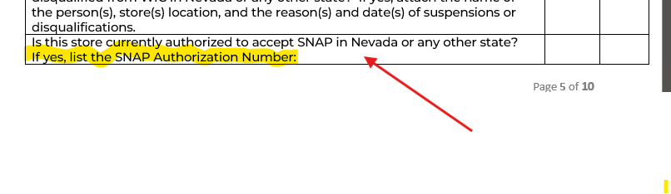
Completing the Application
Your store must be authorized to accept SNAP to be authorized as a Nevada WIC Vendor.

Slide 14
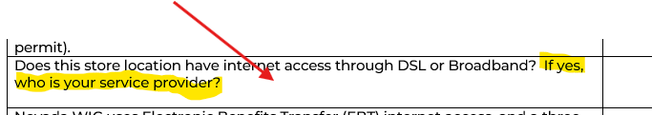
Completing the Application
Page 6:
Complete each “yes”/”no” question and answer the internet access question

Slide 15

Complete and sign
Pages 7-10:
Complete the square footage of the store and number of stores nationwide and statewide
Complete the number of check-out registers including all departments – floral, pharmacy, garden, etc. excluding self-check
Complete the number of self-check registers
Read the non-discrimination statement carefully
Sign and date
Complete attachments

Slide 16
Shelf-Price Survey
Complete prices from lowest brand to highest (where applicable)
Not every item is required, but complete as many as you can
Shelf prices are one factor that help to determine a store’s eligibility to be WIC-Authorized, so an incomplete shelf-price survey is detrimental to your store’s eligibility.

Slide 17
Electronic Cash Register
Section I - Electronic and Point of Sale Systems
Complete each line
Electronic and point of sale system stores must provide the name of the system used
Provide a contact person for your ECR/POS Provider – this is important to provide assistance if there are problems scanning WIC items
Complete the number of retail check out lanes, and indicate how many accept WIC

Slide 18
Electronic Cash Register
Section II – Stand-beside processors
Answer each question
Provide your SNAP number
Complete the contact information for your provider – this is needed to help resolve problems with scanning
Section III – Internet Information
Answer each question
Provide contact information for your internet provider

Slide 19
Attachments
Include these items:
A copy of your insurance declarations page
A copy of your current health permit
The Electronic Cash Register form
The Shelf Price Survey
A current formula invoice

Slide 20
Important Reminders
New store applications are accepted from October 1 – February 1
New stores will have to pass a preauthorization inspection prior to authorization
Reauthorization is every three years, the next reauthorization is in 2027
A separate application must be submitted for each location
Reauthorization does not include an inspection
Reauthorization applications are accepted from April 1 – April 30 – late applications may result in a lapse of service
All agreements expire September 30 of every third year. New stores will need to apply for reauthorization during the reauthorization period regardless of when the agreement started.
Incomplete Applications will be returned.

Slide 21
Please reach out with any questions

Slide 22
DPBHWICVendor@health.nv.gov
775-684-5942
4150 Technology Way, 2nd Floor
Carson City, NV 89706

